Slide 1



















Tahaluf Copyright 2022- All Right Reserved
Harmony IT Solution
learning Hub
Angular
Tahaluf Training Center 2022

Slide 2








Tahaluf Copyright 2022- All Right Reserved
Harmony IT Solution
1
Hit API (Login).
2
Interceptor.
3
Guard.
9

Slide 3










Tahaluf Copyright 2022- All Right Reserved
Harmony IT Solution
Objective

Slide 4
Tahaluf Copyright 2022- All Right Reserved
Harmony IT Solution
The Objective of this lecture
Get Knowe about the Interceptor and how to add the bearer authorization for each request.
Understand the guard concept and how to apply the authorization on the URL.

Slide 5
Tahaluf Copyright 2022- All Right Reserved
Harmony IT Solution
Hits API(Login)

Slide 6
Tahaluf Copyright 2022- All Right Reserved
Harmony IT Solution
Install the jwt-decode package:
This package decodes the token retrieved from the login function.
https://www.npmjs.com/package/jwt-decode
The command :
npm i jwt-decode

Slide 7
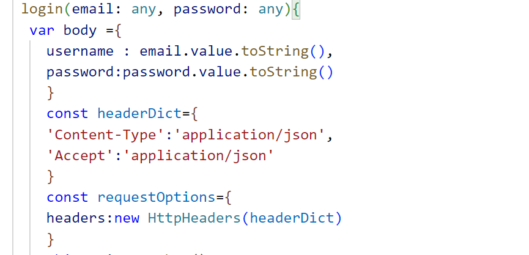
Tahaluf Copyright 2022- All Right Reserved
Harmony IT Solution
How to deal with login function
In order to log in using the email and password which are saved in the database
Notes:
constructor(private spinner: NgxSpinnerService,
private router: Router,
private homeservices: HomeService, private http:HttpClient,public toastr:ToastrService) { }
login(email: any, password: any){
var body ={
username : email.value.toString(),
password:password.value.toString()
}
const headerDict={
'Content-Type':'application/json',
'Accept':'application/json'
}
const requestOptions={
headers:new HttpHeaders(headerDict)
}
this.spinner.show();
this.http.post('https://localhost:44320/api/Login',body,
requestOptions).subscribe((res:any)=>{
this.spinner.hide();
const responce={
token: res.toString() }
localStorage.setItem('token',responce.token);
let data:any=jwt_decode(responce.token);
console.log(data);
localStorage.setItem('user',JSON.stringify({...data}));
if(data.role=='admin')
{
this.router.navigate(['admin/managecourse']);
}
else if (data.role=='customer')
{
this.router.navigate(['home']);
}})
this.spinner.hide();
this.toastr.error('Error on Email or Password ')
}

Slide 8
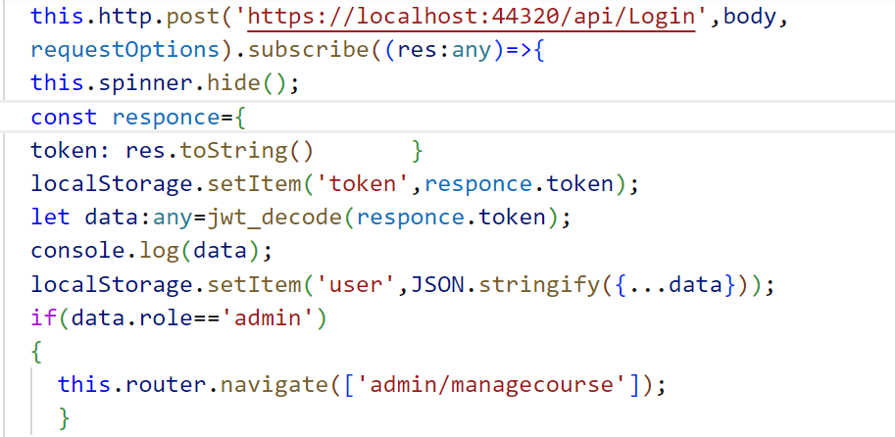
Tahaluf Copyright 2022- All Right Reserved
Harmony IT Solution
How to deal with login function
Notes:
constructor(private spinner: NgxSpinnerService,
private router: Router,
private homeservices: HomeService, private http:HttpClient,public toastr:ToastrService) { }
login(email: any, password: any){
var body ={
username : email.value.toString(),
password:password.value.toString()
}
const headerDict={
'Content-Type':'application/json',
'Accept':'application/json'
}
const requestOptions={
headers:new HttpHeaders(headerDict)
}
this.spinner.show();
this.http.post('https://localhost:44320/api/Login',body,
requestOptions).subscribe((res:any)=>{
this.spinner.hide();
const responce={
token: res.toString() }
localStorage.setItem('token',responce.token);
let data:any=jwt_decode(responce.token);
console.log(data);
localStorage.setItem('user',JSON.stringify({...data}));
if(data.role=='admin')
{
this.router.navigate(['admin/managecourse']);
}
else if (data.role=='customer')
{
this.router.navigate(['home']);
}})
this.spinner.hide();
this.toastr.error('Error on Email or Password ')
}

Slide 9
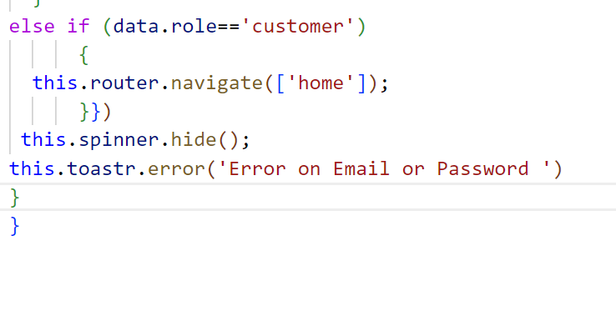
Tahaluf Copyright 2022- All Right Reserved
Harmony IT Solution
How to deal with login function
Notes:
constructor(private spinner: NgxSpinnerService,
private router: Router,
private homeservices: HomeService, private http:HttpClient,public toastr:ToastrService) { }
login(email: any, password: any){
var body ={
username : email.value.toString(),
password:password.value.toString()
}
const headerDict={
'Content-Type':'application/json',
'Accept':'application/json'
}
const requestOptions={
headers:new HttpHeaders(headerDict)
}
this.spinner.show();
this.http.post('https://localhost:44320/api/Login',body,
requestOptions).subscribe((res:any)=>{
this.spinner.hide();
const responce={
token: res.toString() }
localStorage.setItem('token',responce.token);
let data:any=jwt_decode(responce.token);
console.log(data);
localStorage.setItem('user',JSON.stringify({...data}));
if(data.role=='admin')
{
this.router.navigate(['admin/managecourse']);
}
else if (data.role=='customer')
{
this.router.navigate(['home']);
}})
this.spinner.hide();
this.toastr.error('Error on Email or Password ')
}

Slide 10
Tahaluf Copyright 2022- All Right Reserved
Harmony IT Solution
Interceptor

Slide 11
Tahaluf Copyright 2022- All Right Reserved
Harmony IT Solution
Overview of Interceptor
HttpInterceptors are used to handle and intercept the HttpRequest and HttpResponse.

Slide 12
Tahaluf Copyright 2022- All Right Reserved
Harmony IT Solution
Overview of Interceptor
Interceptors transform outgoing requests before passing them to the next interceptor, with the call next.handle(transformedReq).
Interceptors can also transform response event streams through the use of RxJS operators on the stream returned by next.handle ().

Slide 13
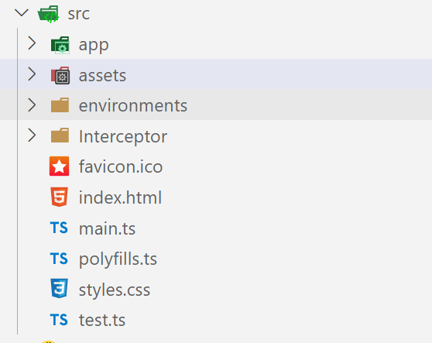
Tahaluf Copyright 2022- All Right Reserved
Harmony IT Solution
How to deal with the interceptor
Create a new folder called Interceptor in the src folder.

Slide 14
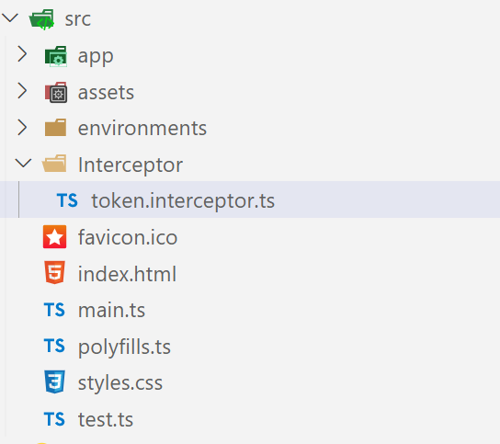
Tahaluf Copyright 2022- All Right Reserved
Harmony IT Solution
How to deal with the interceptor
In this folder create a new file called token.interceptor.ts

Slide 15
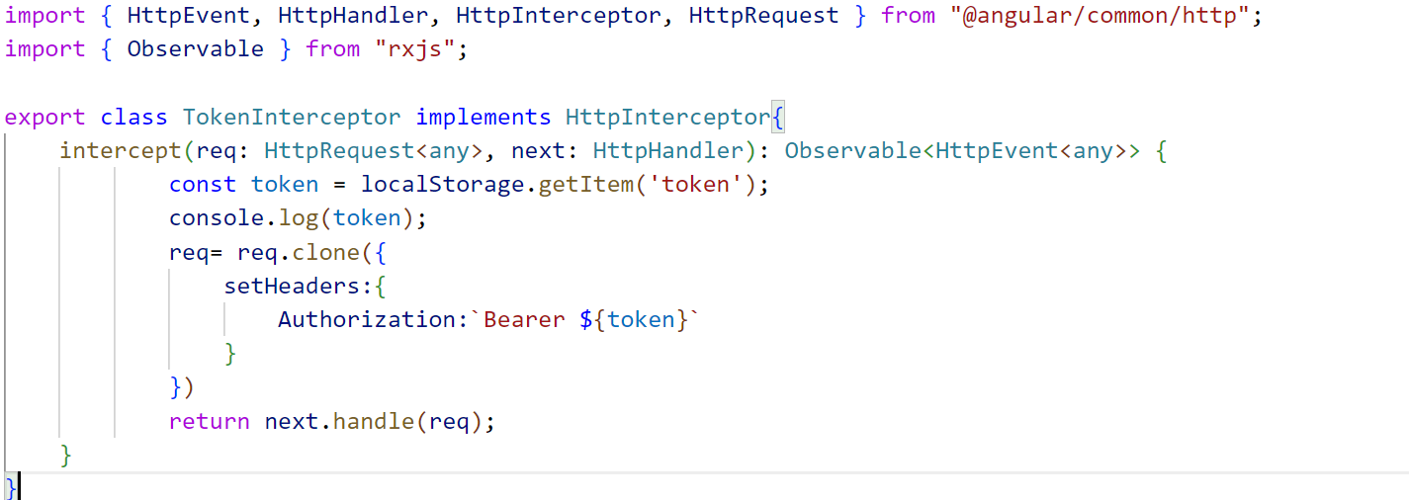
Tahaluf Copyright 2022- All Right Reserved
Harmony IT Solution
How to deal with the interceptor
In token.interceptor.ts:
Notes:
import { HttpEvent, HttpHandler, HttpInterceptor, HttpRequest } from "@angular/common/http";
import { Observable } from "rxjs";
export class TokenInterceptor implements HttpInterceptor{
intercept(req: HttpRequest<any>, next: HttpHandler): Observable<HttpEvent<any>> {
const token = localStorage.getItem('token');
console.log(token);
req= req.clone({
setHeaders:{
Autherization:`Bearer ${token}`
}
})
return next.handle(req);
}
}

Slide 16
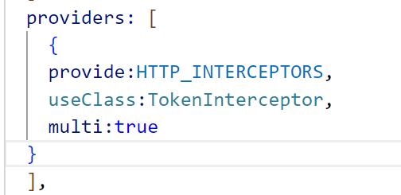
Tahaluf Copyright 2022- All Right Reserved
Harmony IT Solution
How to deal with the interceptor
Apply the interceptor class In the App Module
In app.module.ts (In providers array ):
Notes:
providers: [{
provide:HTTP_INTERCEPTORS,
useClass:TokenInterceptor,
multi:true
}],

Slide 17
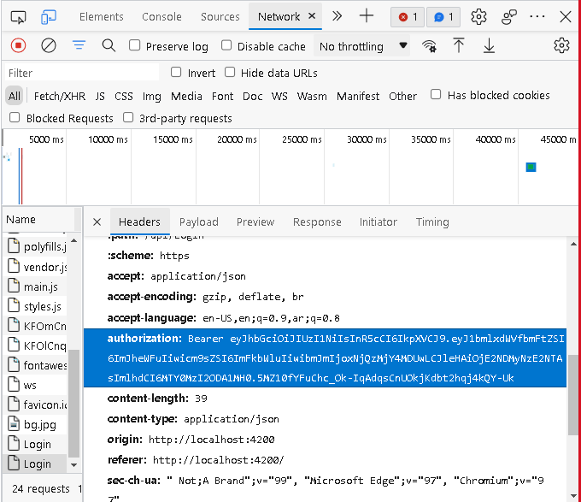
Tahaluf Copyright 2022- All Right Reserved
Harmony IT Solution
The Result

Slide 18
Tahaluf Copyright 2022- All Right Reserved
Harmony IT Solution
Guard

Slide 19
Tahaluf Copyright 2022- All Right Reserved
Harmony IT Solution
Overview of Guard
CanActivate: This interface lets classes implement guards that decide whether a route can be activated. Navigation continues if all guards return true. Navigation is canceled if any guard returns false. The current navigation is canceled if any guard returns a UrlTree and new navigation begins based on the UrlTree.

Slide 20
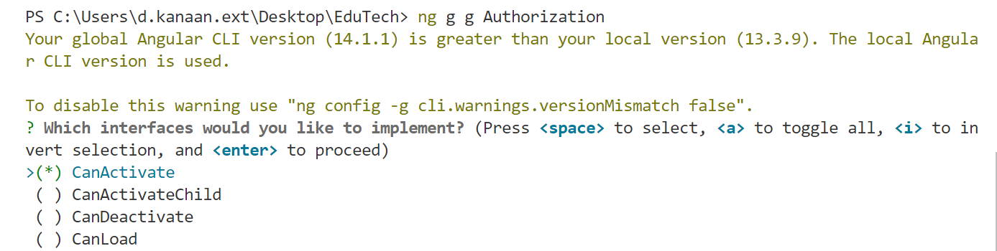
Tahaluf Copyright 2022- All Right Reserved
Harmony IT Solution
How to include the guard in the project
Generate a new guard via this command :
ng generate guard guardName or ng g g guardName. (Chose canActivate )
Notes:
export class AutherizationGuard implements CanActivate {
constructor(private router:Router, private toaster:ToastrService){}
canActivate(
route: ActivatedRouteSnapshot,
state: RouterStateSnapshot): Observable<boolean | UrlTree> | Promise<boolean | UrlTree> | boolean | UrlTree {
const token=localStorage.getItem('token');
if(token)
{
if(state.url.indexOf('admin')>=0)
{
let user : any =localStorage.getItem('user');
user=JSON.parse(user);
if(user.role=='admin')
{
this.toaster.success('Welcome on Admin Dashbord')
return true;
}
else {
this.toaster.warning('this page for admin');
this.router.navigate(['homepage']);
return false;
}
}
console.log(state);
return true;
}
else {
this.router.navigate(['security/login']);
this.toaster.warning('You are not Authorized');
return false;
}
}
}

Slide 21
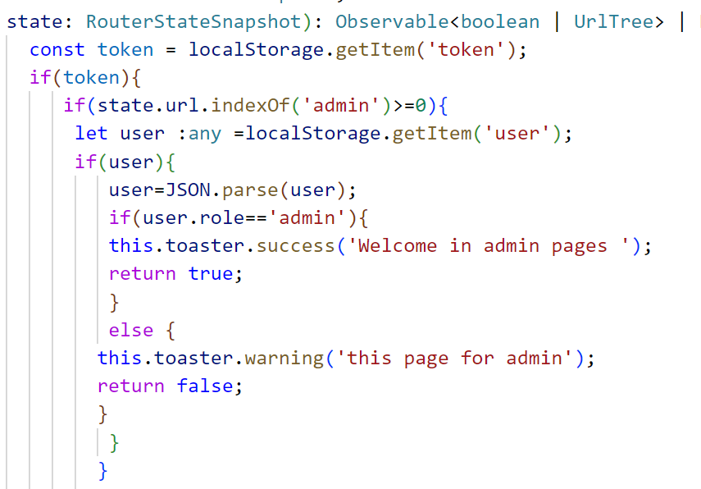
Tahaluf Copyright 2022- All Right Reserved
Harmony IT Solution
How to include the guard in the project
Notes:
export class AutherizationGuard implements CanActivate {
constructor(private router:Router, private toaster:ToastrService){}
canActivate(
route: ActivatedRouteSnapshot,
state: RouterStateSnapshot): Observable<boolean | UrlTree> | Promise<boolean | UrlTree> | boolean | UrlTree {
const token=localStorage.getItem('token');
if(token)
{
if(state.url.indexOf('admin')>=0)
{
let user : any =localStorage.getItem('user');
user=JSON.parse(user);
if(user.role=='admin')
{
this.toaster.success('Welcome on Admin Dashbord')
return true;
}
else {
this.toaster.warning('this page for admin');
this.router.navigate(['homepage']);
return false;
}
}
console.log(state);
return true;
}
else {
this.router.navigate(['security/login']);
this.toaster.warning('You are not Authorized');
return false;
}
}
}

Slide 22
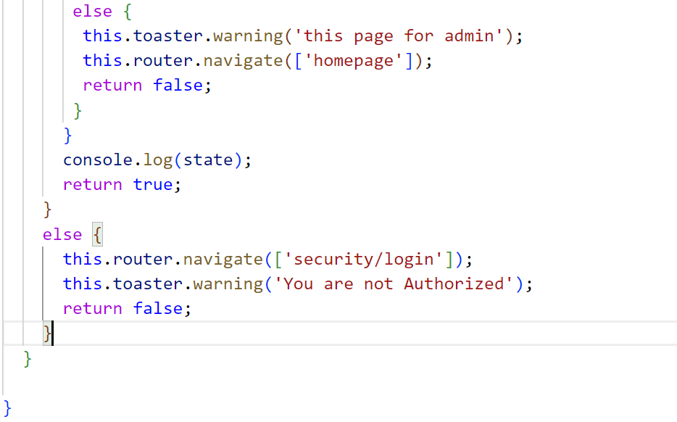
Tahaluf Copyright 2022- All Right Reserved
Harmony IT Solution
How to include the guard in the project
Notes:
export class AutherizationGuard implements CanActivate {
constructor(private router:Router, private toaster:ToastrService){}
canActivate(
route: ActivatedRouteSnapshot,
state: RouterStateSnapshot): Observable<boolean | UrlTree> | Promise<boolean | UrlTree> | boolean | UrlTree {
const token=localStorage.getItem('token');
if(token)
{
if(state.url.indexOf('admin')>=0)
{
let user : any =localStorage.getItem('user');
user=JSON.parse(user);
if(user.role=='admin')
{
this.toaster.success('Welcome on Admin Dashbord')
return true;
}
else {
this.toaster.warning('this page for admin');
this.router.navigate(['homepage']);
return false;
}
}
console.log(state);
return true;
}
else {
this.router.navigate(['security/login']);
this.toaster.warning('You are not Authorized');
return false;
}
}
}

Slide 23
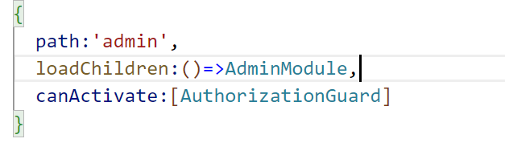
Tahaluf Copyright 2022- All Right Reserved
Harmony IT Solution
Apply the guard on the admin module
Notes:
{
path:'admin',
loadChildren:()=>AdminModule,
canActivate:[AuthorizationGuard]
}

Slide 24
Tahaluf Copyright 2022- All Right Reserved
Harmony IT Solution
References
[1] Angular, “Angular,” Angular.io, 2019. https://angular.io/
[2] “Complete Angular Tutorial For Beginners,” TekTutorialsHub. https://www.tektutorialshub.com/angular-tutorial/
[3]“npm | build amazing things,” Npmjs.com, 2019. https://www.npmjs.com/
[4]“Angular Tutorial for Beginners | Simplilearn,” Simplilearn.com. https://www.simplilearn.com/tutorials/angular-tutorial (accessed Aug. 19, 2022).
Overview of Database

Slide 25








Tahaluf Copyright 2022- All Right Reserved
Harmony IT Solution
Thank youﻂﺤﻧ
Any Question?

